Slide 1
The Concept of a Stream
Use of files
  Store Java classes, programs
  Store pictures, music, videos
  Can also use files to store program I/O
A stream is a flow of input or output data
  Characters
  Numbers
  Bytes

Slide 2
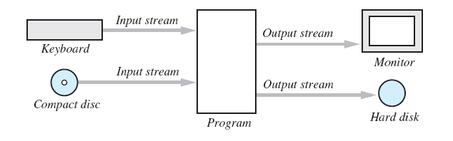
The Concept of a Stream
Streams are implemented as objects of special stream classes
  Class Scanner
  Object System.out
I/O Streams

Slide 3
Why Use Files for I/O
Keyboard input, screen output deal with temporary data
  When program ends, data is gone
Data in a file remains after program ends
  Can be used next time program runs
  Can be used by another program

Slide 4
Text Files and Binary Files
All data in files stored as binary digits
  Long series of zeros and ones
Files treated as sequence of characters called text files
  Java program source code
  Can be viewed, edited with text editor
All other files are called binary files
  Movie, music files
  Access requires specialized program

Slide 5
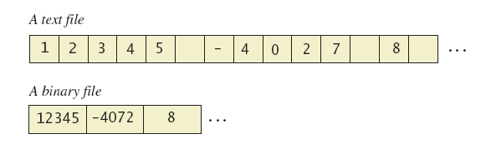
Text Files and Binary Files
A text file and a binary file containing the same values

Slide 6
Creating a Text File
Class PrintWriter defines methods needed to create and write to a text file
  Must import package java.io
To open the file
  Declare stream variable for referencing the stream
  Invoke PrintWriter constructor, pass file name as argument
  Requires try and catch blocks

Slide 7
Creating a Text File
File is empty initially
  May now be written to with method println
Data goes initially to memory buffer
  When buffer full, goes to file
Closing file empties buffer, disconnects from stream

Slide 8
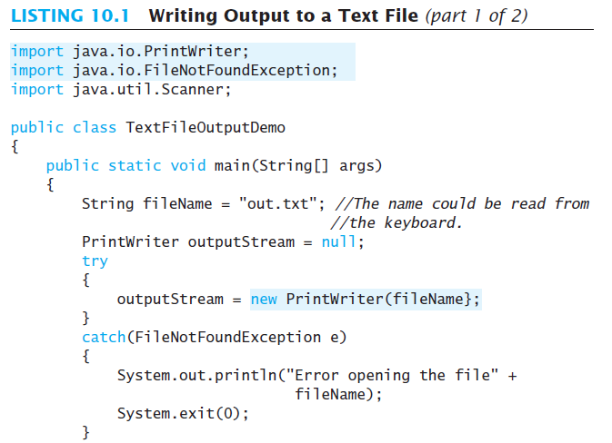

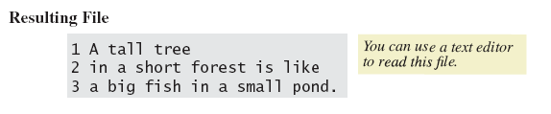
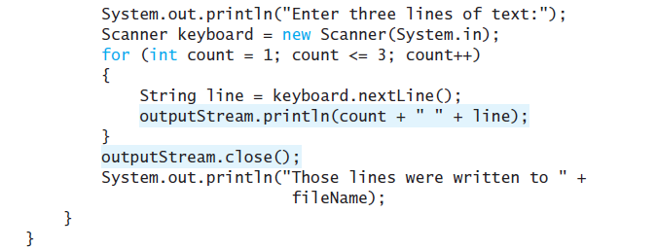
Creating a Text File
Sample
screen output

Slide 9
Creating a Text File
When creating a file
  Inform the user of ongoing I/O events, program should not be "silent"
A file has two names in the program
  File name used by the operating system
  The stream name variable
Opening, writing to file overwrites pre-existing file in directory

Slide 10
Appending to a Text File
Opening a file new begins with an empty file
  If already exists, will be overwritten
Some situations require appending data to existing file
Command could be
outputStream =
new PrintWriter(
new FileOutputStream(fileName, true));
Method println would append data at end

Slide 11
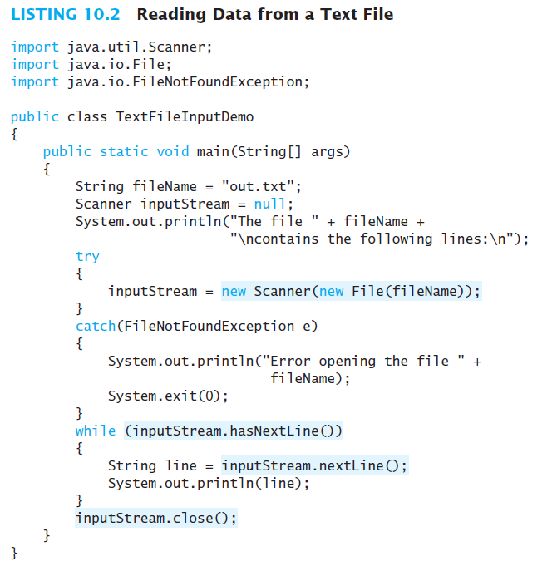
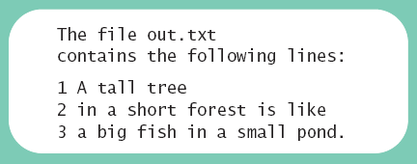
Reading from a Text File
Reads text from file, displays on screen
  Statement which opens the file
  Use of Scanner object
  Boolean statement which reads the file and terminates reading loop
Sample
screen output

Slide 12
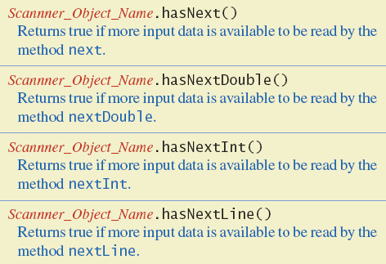
Reading from a Text File
Additional methods in class Scanner

Slide 13
Techniques for Any File
The Class File
Programming Example: Reading a File Name from the Keyboard
Using Path Names
Methods of the Class File
Defining a Method to Open a Stream

Slide 14
The Class File
Class provides a way to represent file names in a general way
  A File object represents the name of a file
The object
new File ("treasure.txt")
is not simply a string
  It is an object that knows it is supposed to name a file

Slide 15
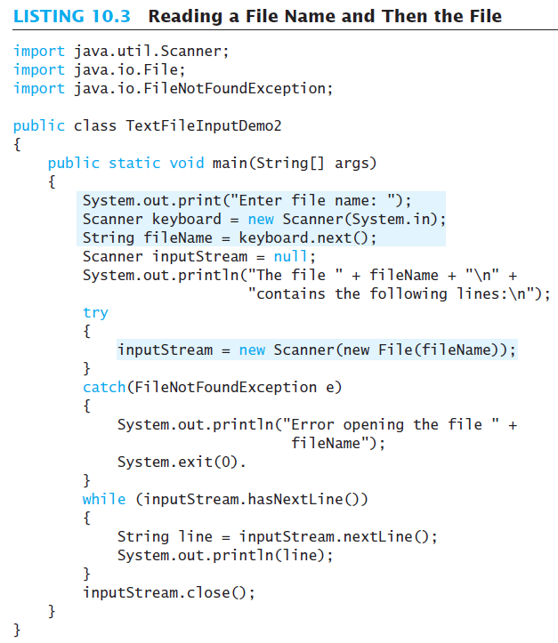
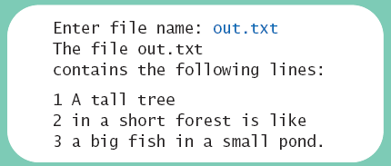
Programming Example
Sample
screen output

Slide 16
Using Path Names
Files opened in our examples assumed to be in same folder as where program run
Possible to specify path names
  Full path name
  Relative path name
Be aware of differences of pathname styles in different operating systems

Slide 17
Methods of the Class File
Recall that a File object is a system-independent abstraction of file's path name
Class File has methods to access information about a path and the files in it
  Whether the file exists
  Whether it is specified as readable or not
  Etc.

Slide 18
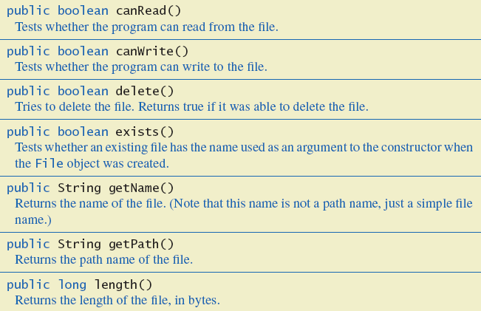
Methods of the Class File
Some methods in class File

Slide 19
Defining a Method to Open a Stream
Method will have a String parameter
  The file name
Method will return the stream object
Will throw exceptions
  If file not found
  If some other I/O problem arises
Should be invoked inside a try block and have appropriate catch block

Slide 20
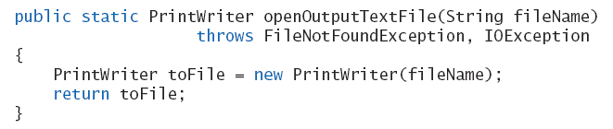
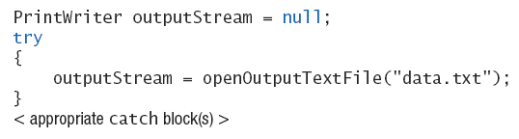
Defining a Method to Open a Stream
Example code
Example call

Slide 21
Case Study
Processing a Comma-Separated Values File
A comma-separated values or CSV file is a simple text format used to store a list of records
Example from log of a cash register’s transactions for the day:
SKU,Quantity,Price,Description
4039,50,0.99,SODA
9100,5,9.50,T-SHIRT
1949,30,110.00,JAVA PROGRAMMING TEXTBOOK
5199,25,1.50,COOKIE

Slide 22
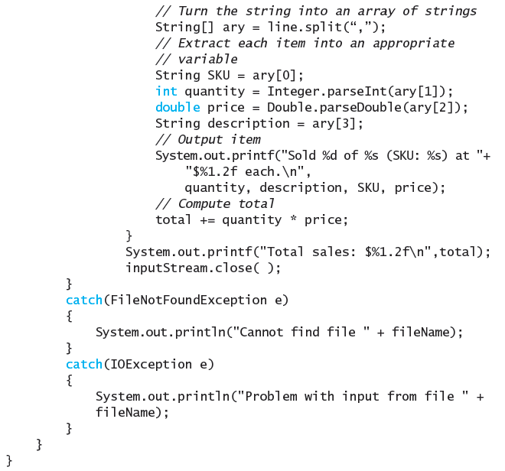
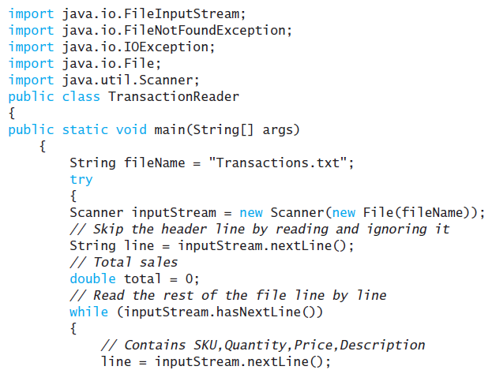
Example Processing a CSV File

Slide 23
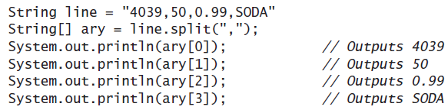
Example Processing a CSV File
class TransactionReader
Uses the split method which puts strings separated by a delimiter into an array

Slide 24
Basic Binary-File I/O
Creating a Binary File
Writing Primitive Values to a Binary File
Writing Strings to a Binary File
The Class EOFException
Programming Example: Processing a File of Binary Data

Slide 25
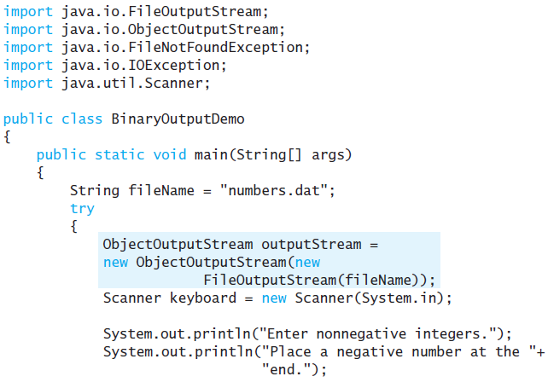
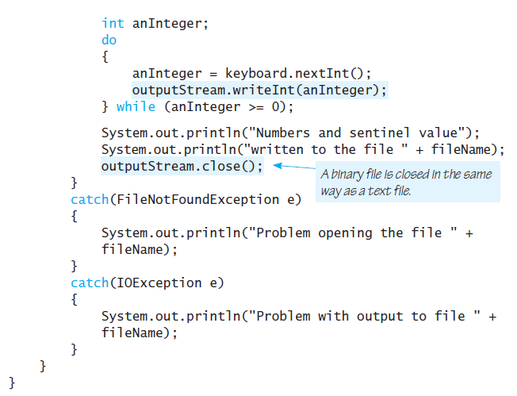
Creating a Binary File
Stream class ObjectOutputStream allows files which can store
  Values of primitive types
  Strings
  Other objects
View program which writes integers

Slide 26

Creating a Binary File
Sample
screen output
Note the line to open the file
  Constructor for ObjectOutputStream cannot take a String parameter
  Constructor for FileOutputSream can

Slide 27
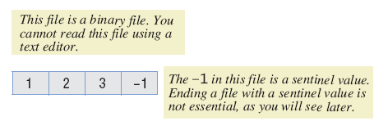
Writing Primitive Values to a Binary File
Method println not available
  Instead use writeInt method
Binary file stores numbers in binary form
  A sequence of bytes
  One
  immediately
  after another

Slide 28
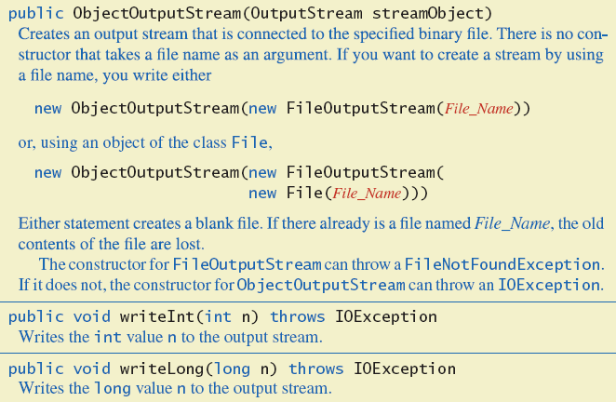
Writing Primitive Values to a Binary File
Some methods in class ObjectOutputStream

Slide 29
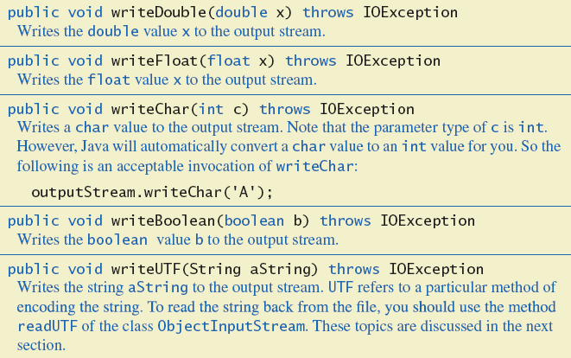
Writing Primitive Values to a Binary File
Some methods in class ObjectOutputStream

Slide 30
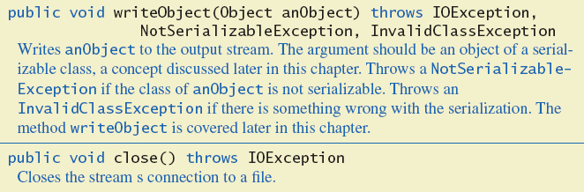
Writing Primitive Values to a Binary File
Some methods in class ObjectOutputStream

Slide 31
Writing Strings to a Binary File
Use method writeUTF
Example
outputStream.writeUTF("Hi Mom");
UTF stands for Unicode Text Format
Uses a varying number of bytes to store different strings
  Depends on length of string
  Contrast to writeInt which uses same for each

Slide 32
Reading from a Binary File
File must be opened as an
ObjectInputStream
Read from binary file using methods which correspond to write methods
  Integer written with writeInt will be read with readInt
Be careful to read same type as was written

Slide 33
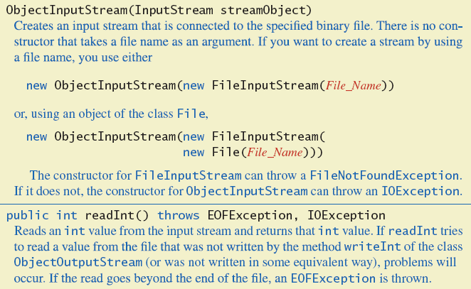
Reading from a Binary File
Some methods of class ObjectInputStream

Slide 34
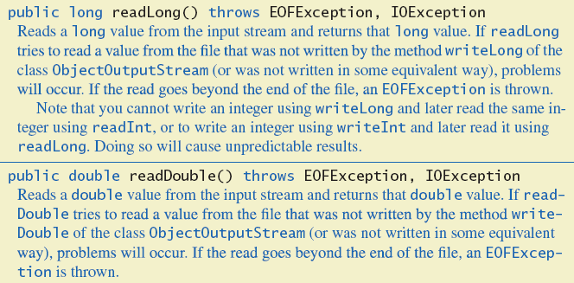
Reading from a Binary File
Some methods of class ObjectInputStream

Slide 35
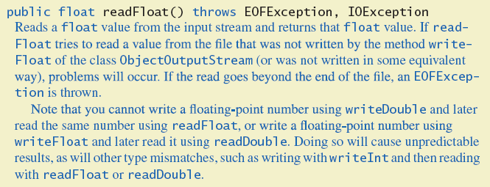
Reading from a Binary File
Some methods of class ObjectInputStream

Slide 36
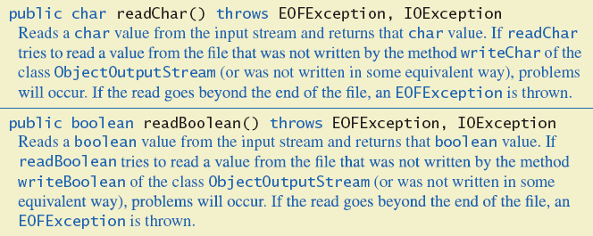
Reading from a Binary File
Some methods of class ObjectInputStream

Slide 37
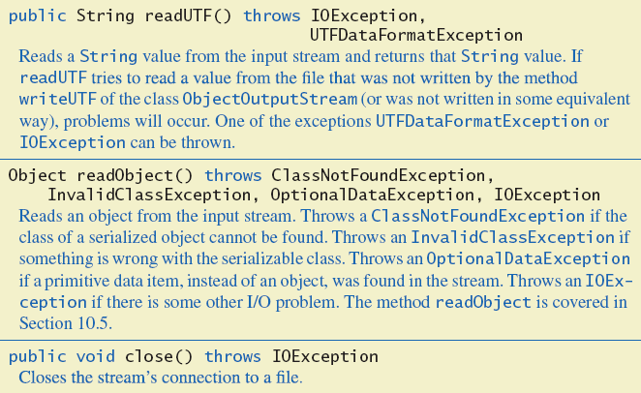
Reading from a Binary File
Some methods of class ObjectInputStream

Slide 38
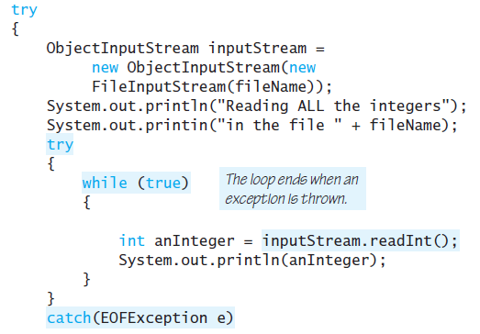
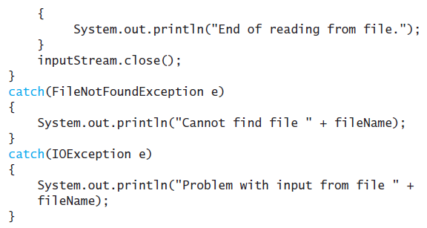
The Class EOFException
Many methods that read from a binary file will throw an EOFException
  Can be used to test for end of file
  Thus can end a reading loop

Slide 39
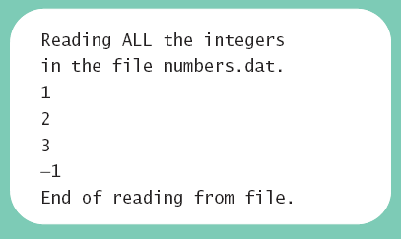
The Class EOFException
Note the -1 formerly needed as a sentinel value is now also read
Always a good idea to check for end of file even if you have a sentinel value
Sample
screen output

Slide 40
Binary-File I/O, Objects & Arrays
Binary-File I/O with Objects of a Class
Some Details of Serialization
Array Objects in Binary Files

Slide 41
Binary-File I/O with Class Objects
Consider the need to write/read objects other than Strings
  Possible to write the individual instance variable values
  Then reconstruct the object when file is read
A better way is provided by Java
  Object serialization – represent an object as a sequence of bytes to be written/read
  Possible for any class implementing Serializable

Slide 42
Binary-File I/O with Class Objects
Interface Serializable is an empty interface
  No need to implement additional methods
  Tells Java to make the class serializable (class objects convertible to sequence of bytes)

Slide 43
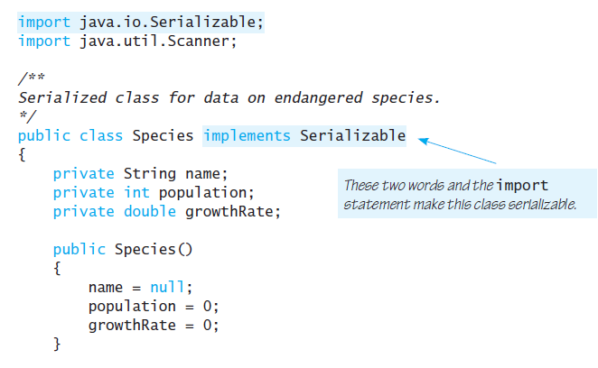
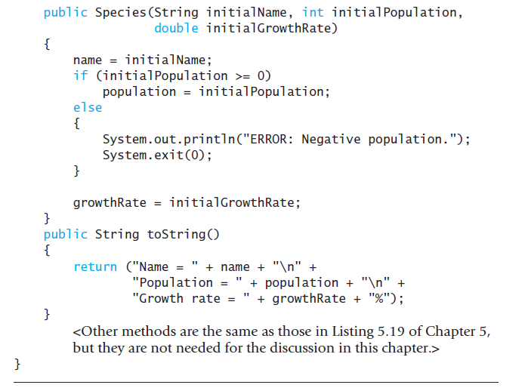
Binary-File I/O with Class Objects

Slide 44
Binary-File I/O with Class Objects
Once we have a class that is specified as Serializable we can write objects to a binary file
  Use method writeObject
Read objects with method readObject();
  Also required to use typecast of the object

Slide 45
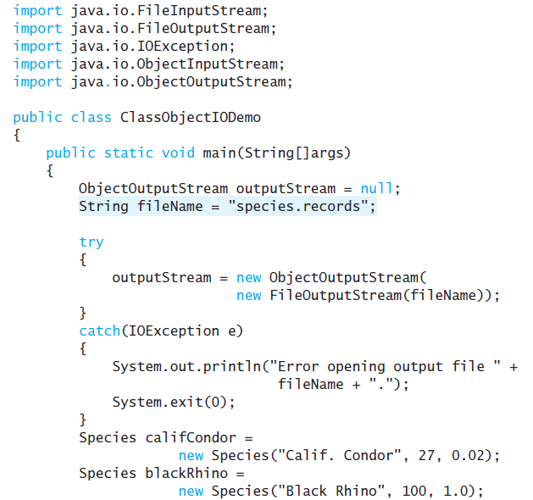
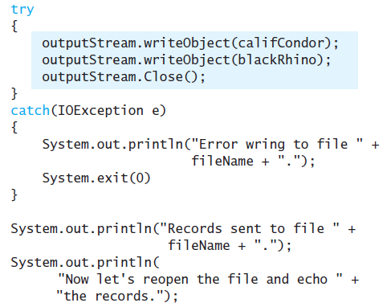
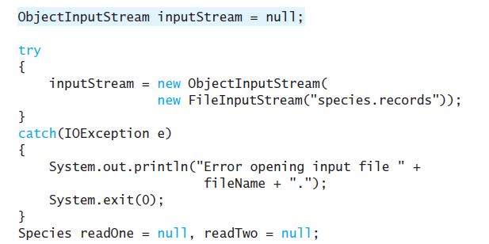
Binary-File I/O with Class Objects

Slide 46
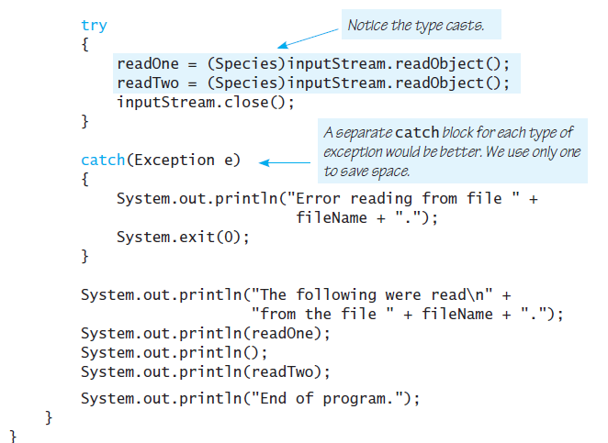
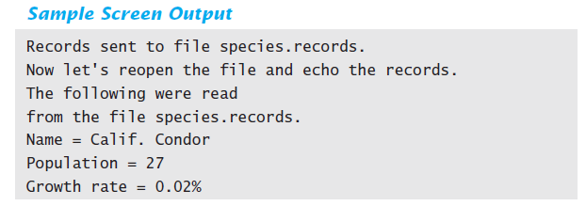
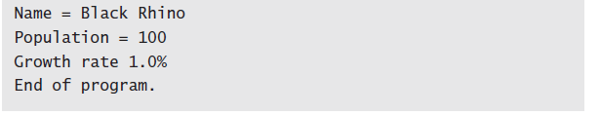
Binary-File I/O with Class Objects

Slide 47
Some Details of Serialization
Requirements for a class to be serializable
  Implments interface Serializable
  Any instance variables of a class type are also objects of a serializable class
  Class's direct superclass (if any) is either serializable or defines a default constructor

Slide 48
Some Details of Serialization
Effects of making a class serializable
  Affects how Java performs I/O with class objects
  Java assigns a serial number to each object of the class it writes to the ObjectOutputStream
  If same object written to stream multiple times, only the serial number written after first time

Slide 49
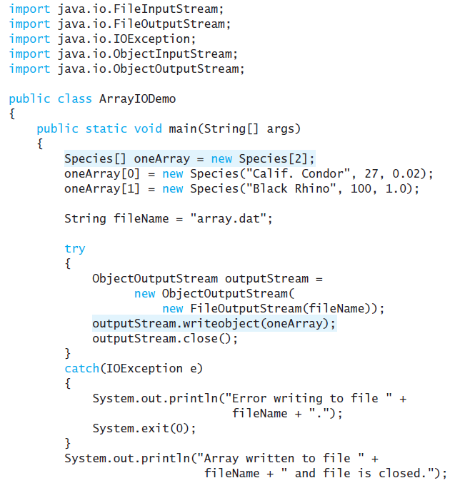
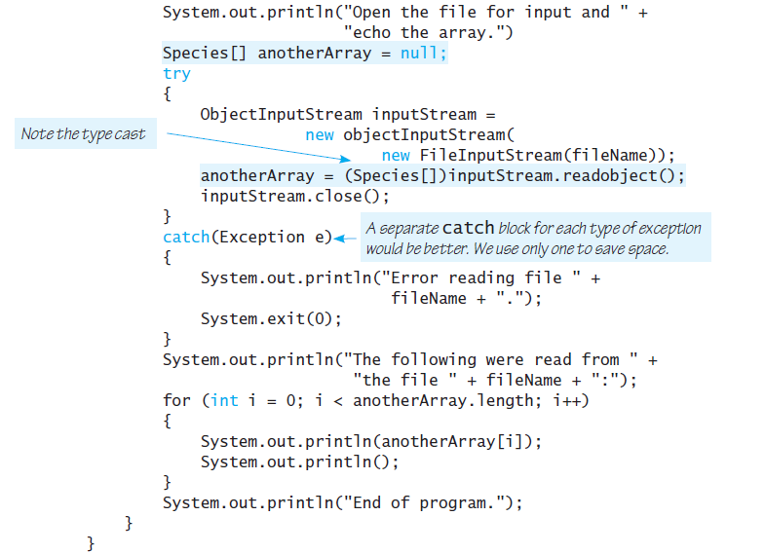
Array Objects in Binary Files
Since an array is an object, possible to use writeObject with entire array
  Similarly use readObject to read entire array

Slide 50
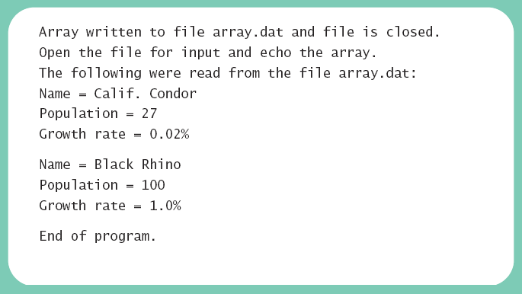
Array Objects in Binary Files
Sample
screen output

